Slide 1
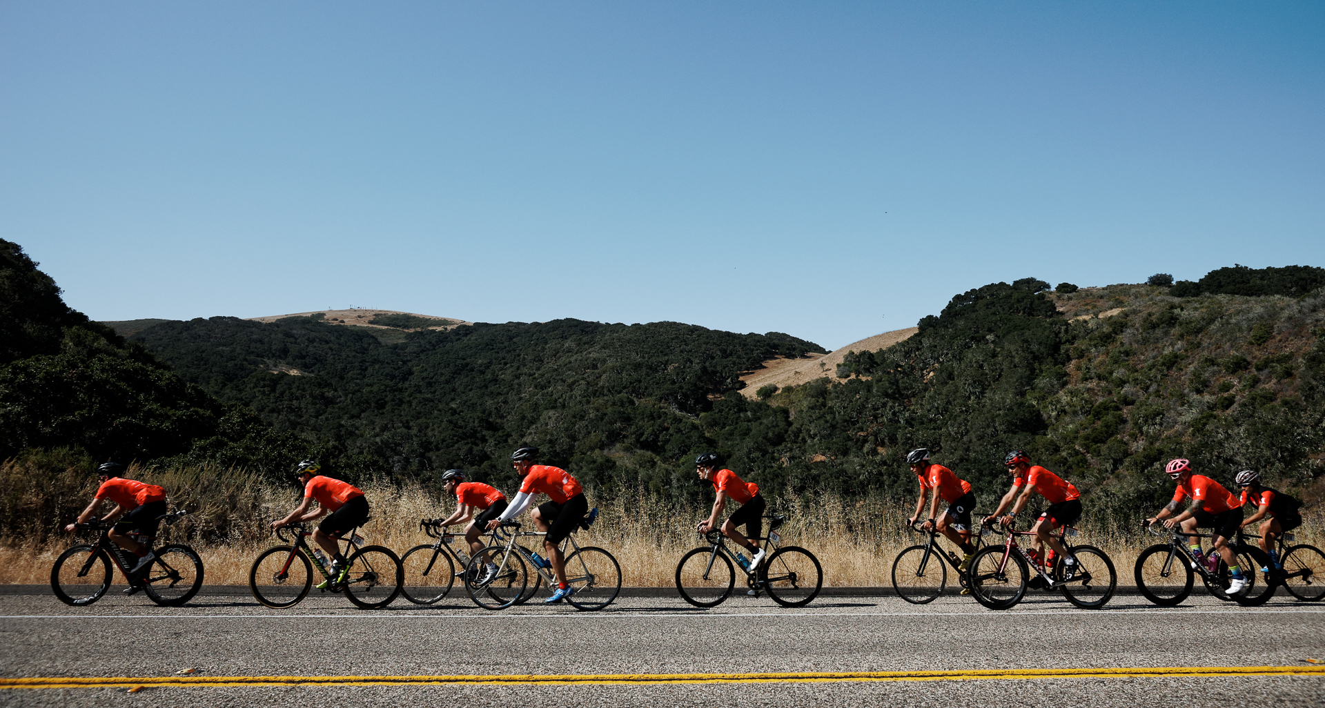



CHEFS CYCLE
May 16-18, 2017 | Sonoma County, CA
CHEF PHOTO HERE
RIDER NAME
RESTAURANT NAME
Support Chef Name as he/she rides 300 miles in three days to help end childhood hunger. $1 can feed a child 10 healthy meals.
For more information on how you can help, visit ChefsCycle.org

